Slide 1
Heart Analysis
Data set by kaggle

Slide 2
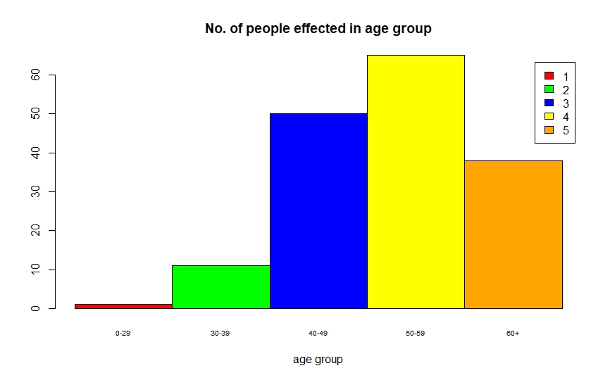
No. of people effected by heart disease from age group

Slide 3
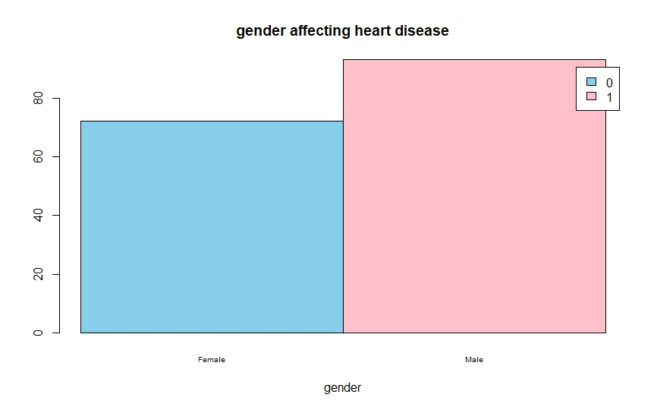
Analysis on the base of gender who are effected by heart disease

Slide 4
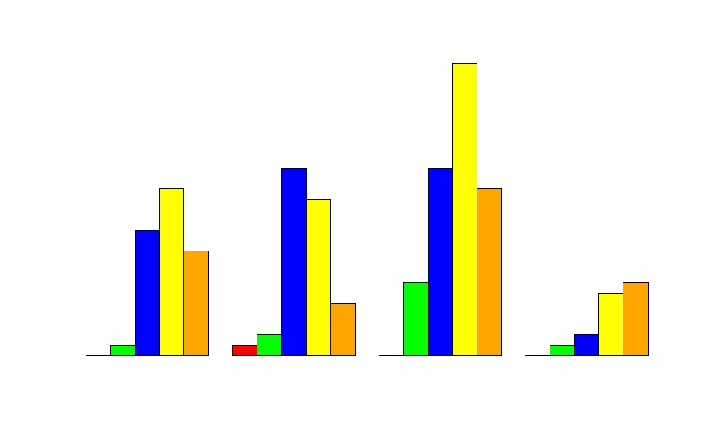
Age wise range effected by heart disease

Slide 5
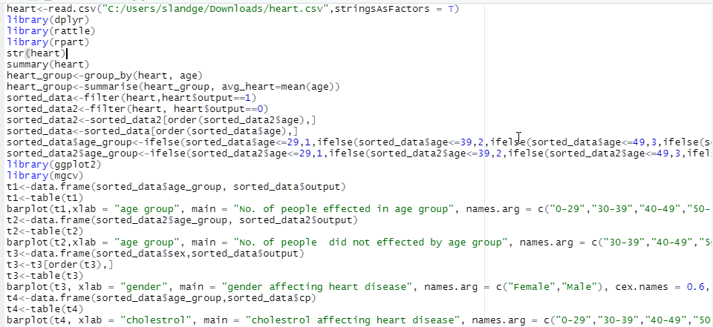
Codes uptill now

Slide 6
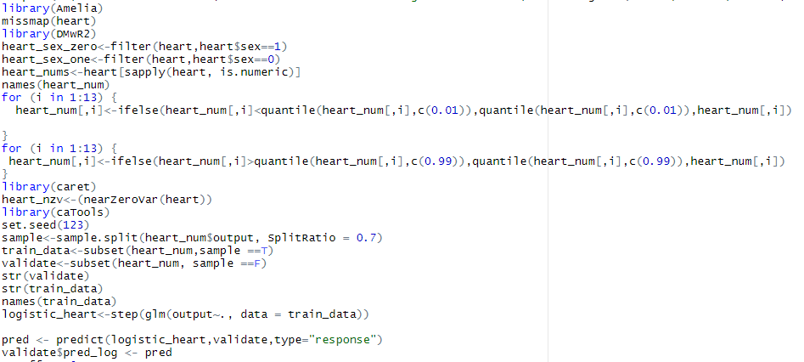
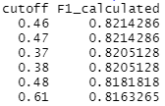
After building the model we found that F1 calculated was 82% when both male and female were together.

Slide 7
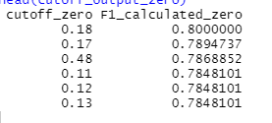
After separating both female and male the prediction was increased.

Slide 8
For male:
For male F1 calculated is 96%

